Slide 1






Welcome
RIIO-ED2 Business Plan:
first submission to Ofgem
Our webinar will begin in a few minutes.
Please use the Q&A button to post your questions about the business plan.
We will try to answer as many questions as possible at the end of presentation.
21 July 2021
westernpower.co.uk

Slide 2
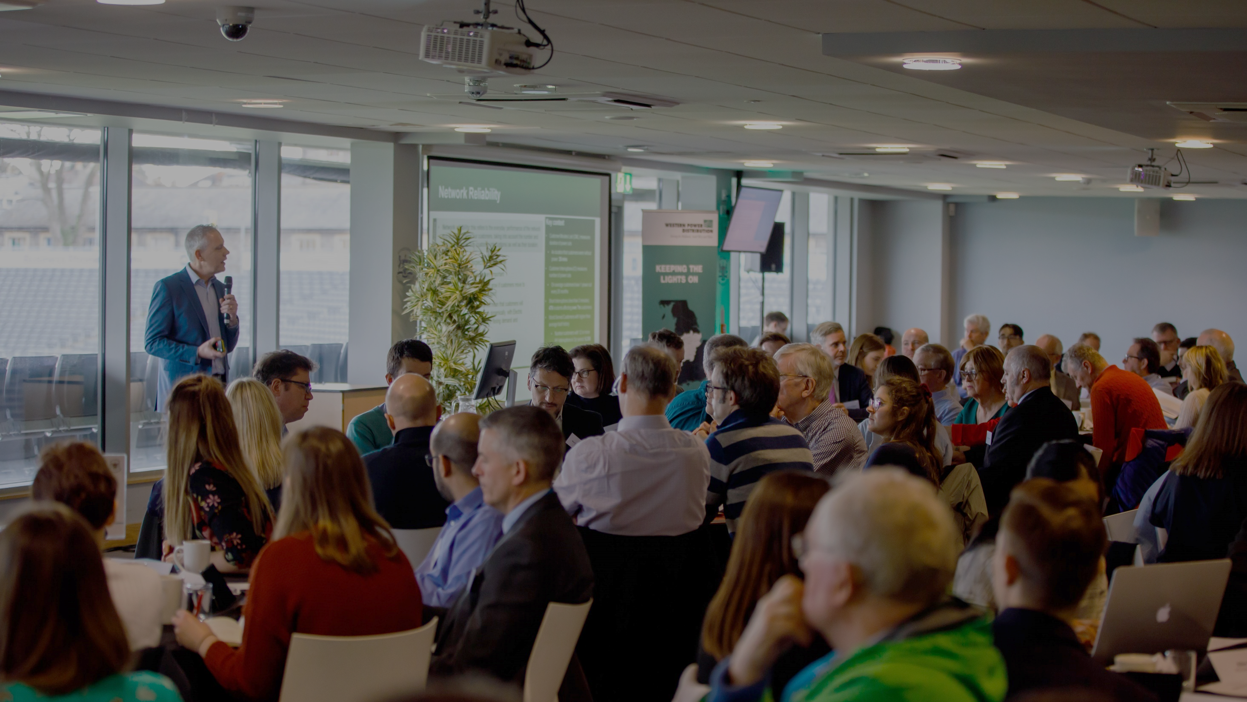





Introducing WPD’s first Business Plan
submission to Ofgem
Mark Shaw
RIIO-ED2 Business Plan Manager
Wednesday 21st July 2021
westernpower.co.uk

Slide 3
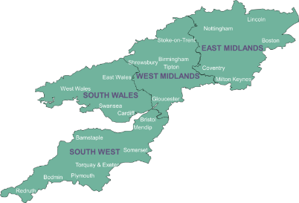



Setting the scene
We distribute power to 8 million homes & businesses
Covering the East and West Midlands, South Wales and South West England
Our focus is to deliver affordable excellent customer service by keeping the light on and ensuring customers can have a connection when they want it.
Ofgem regulates how much revenue we can earn and what we must deliver in ‘price control periods’
“RIIO-ED2” will cover the 5 years 2023-2028
We are developing our Business Plan for that period - setting out, in detail, our commitments to stakeholders, performance targets and planned investment and expenditure
“RIIO-ED2”:
Revenue = Incentives + Innovation + Outputs (Electricity Distribution 2)
westernpower.co.uk

Slide 4
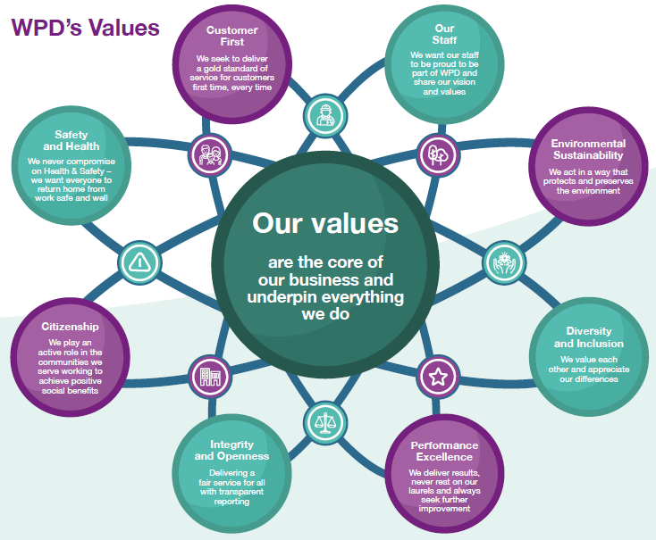
Our values – underpinning our Business Plan
Our purpose is to deliver exceptional service and support environmental and social well being for the communities we serve through our commitment to deliver:
‘Power for life, Power for future generations’.
We will deliver a safe and reliable electricity supply at an affordable cost for all our customers, using local staff to deliver a local service
We will achieve this by following our values which are at the core of our business and underpin everything we do:
“RIIO-ED2”:
Revenue = Incentives + Innovation + Outputs (Electricity Distribution 2)
westernpower.co.uk

Slide 5


How our plan was built
While this is our first submission to Ofgem and their Challenge Group, it is the third draft we have published for stakeholder consultation
We are maximising the opportunities for you to shape our plans and ensure our proposals are fully well-justified:
82%
end user acceptability
of the overall plan
(only 3% “unacceptable”)
January 2021
BP1 published and consultation
March 2021
BP2 published and consultation
July 2021
BP3 (first submission to Ofgem) published and consultation
87% - 97%
stakeholder acceptability of WPD’s core commitments
December 2021
BP4 (final submission to Ofgem) published and consultation
westernpower.co.uk

Slide 6



How our plan was built
Over 19,000 stakeholders engaged via 250 events (over 6,400 via direct, in-person engagement)
For example:
In addition we’ve considered over 70,000 customer interactions
Every commitment has been co-created from a blank sheet through to detailed and refined targets
 | Commitment | Phase 1 Preliminary engagement | Phase 2 Social value | Phase 3 Business Plan development | Phase 4 Business Plan refinement | Phase 5 Business Plan acceptance
6 | Proactively contact over two million Priority Services Register customers once every two years (with 60% via direct telephone call) to remind them of the services we provide and update their records. |  |  |  | 
7 | Achieve a 'one-stop-shop' service so that customers only have to join the Priority Services Register once to be registered automatically with their energy supplier, water company, gas distributor and telecommunications companies. |  |  |  | 
8 | Increase the number of customers registered on the Priority Services Register to 40% of total eligible customers including 50,000 hard-to-reach customers each year. |  |  |  | 
9 | Support 113,000 fuel poor customers to save £60 million on their energy bills over RIIO-ED2. |  |  |  | 
10 | 600,000 Priority Services Register customers to be offered a bespoke smart energy action plan each year. |  |  |  | 
✓
Key:
 | No stakeholder support at that stage |  | Action specifically requested by stakeholders
 | Regulatory or legislative drivers (including suggested actions from WPD based on our expertise, but not yet tested with stakeholders) |  | Specific action reviewed and agreed with stakeholders
 | High level stakeholder support (e.g. indicating this overall area of activity is a priority, but not yet indicating specific actions) |  | Increased ambition following feedback
westernpower.co.uk

Slide 7

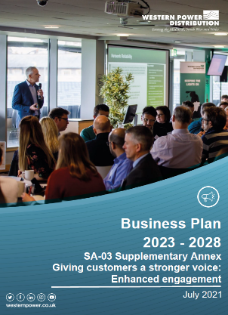

What we have published
www.westernpower.co.uk/RIIO-ED2BusinessPlan
core documents
supplementary annexes
key strategies
5
11
12
Governance
Keep our promises
Engagement
Commitments
Smart and flexible network
Expenditure
Uncertainty
Competition
Financing
Glossary
Investment appraisal
Climate resilience
Customer vulnerability
Digitalisation
DSO
ENA innovation
Environment
Environmental Action Plan
WPD Innovation
Major connections
Social contract
Workforce resilience
RIIO-ED2 Business Plan
Business Plan Overview
Navigating our Plan
Board Assurance Statement
Redaction Explanatory Statement
Plus 8 Customer Value Propositions
westernpower.co.uk

Slide 8
We keep our promises
Our delivery track record is essential to ensure our Business Plan is believable and credible. It contains ambitious targets our customers can have confidence will be achieved
In some areas, stakeholders want us to maintain our focus and build on our successful track record, by making ongoing improvements
In others, they want us to embrace entirely new ways of operating and to develop new services that deliver a rapidly evolving energy system that drives a lower carbon future for us all.
We have a strong track record of delivering on our promises. This will not change in RIIO-ED2.
9.01 out of 10
overall satisfaction in RIIO-ED1
8 years
Highest rated company in Ofgem’s Stakeholder and Consumer Vulnerability incentive
40%
reduction in power cuts and 50% reduction in power cut durations
20%
reduction in business carbon footprint in RIIO-ED1
£37 million
Savings delivered to fuel poor customer in RIIO-ED1 – four times more than any other DNO
Largest flexibility
programme in the UK, with 457MW procured and £39m deferred reinforcement
westernpower.co.uk

Slide 9
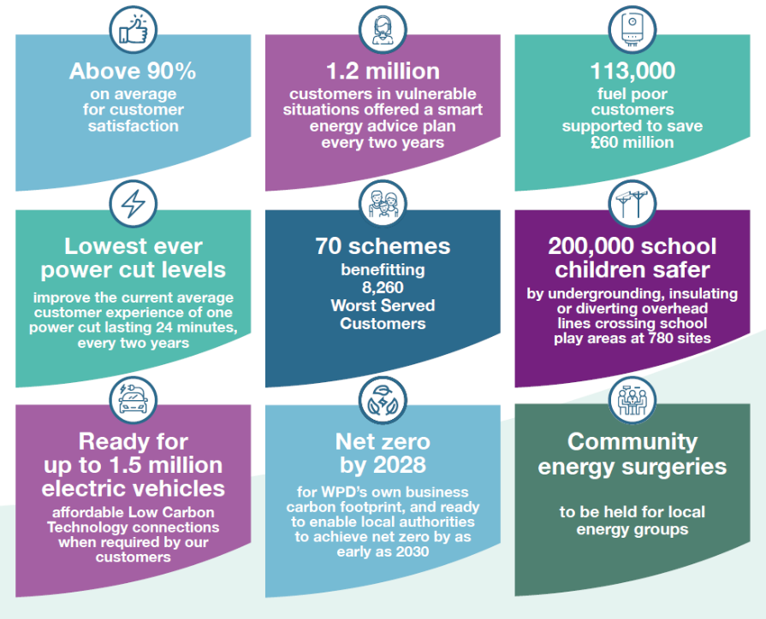
Headlines of our plan - Commitments
We have proposed 45 core commitments
We have followed a five stage engagement process to co-create them with stakeholders, from scratch
They have been significantly refined and negotiated, with over 3,000 stakeholders inputting in the last 6 months alone to refine BP1 to BP2 to BP3
Consolidated, specific and measurable
With a clear focus on outcomes and the benefits they will achieve for our customers
67
58
45
commitments
commitments
commitments
westernpower.co.uk

Slide 10
Headlines of our plan – Commitments (2)
In addition to our 45 core commitments, we have made 162 wider commitments
Detailed action plans, performance reporting metrics and overviews of the stakeholder insights that have driven our decisions are contained in our supplementary annexes and strategies
For example (Customer vulnerability):
core commitments
wider commitments
reporting metrics
5
39
For example:
(#6) Proactively contact over 2 million Priority Service Register customers once every two years (60% via direct telephone call) to remind them of the services we provide and update their records.
(#9) Support 113,000 fuel poor customers to save £60 million on their energy bills over RIIO-ED2.
(#10) 600,000 Priority Services Register customers to be offered a bespoke smart energy action plan each year.
For example:
(#20) Model the capabilities of vulnerable customers to participate in a smart, low carbon future, and then: calibrate existing schemes; design and implement new interventions to support participation.
(#26) Power Up Smart scheme to tailored support for PSR customers with smart meters.
(#28) Annual fuel poverty innovation competition seeking innovative projects to tackle fuel poverty.
(#30) Every WPD innovation scheme will formally consider the impacts and opportunities for customers in vulnerable situations.
22
westernpower.co.uk

Slide 11





Headlines of our plan – An example topic: Environment
Ready to provide the capacity to facilitate the net zero aspirations of our local communities
We plan to help connect up to 1.5 million electric vehicles and 600,000 heat pumps.
We will work closely with local authorities and other stakeholders to ensure our forecasts reflect regional low carbon plans.
We have already successfully established flexibility markets and procured the highest amount of flexibility of all UK DNOs.
This ‘flexibility first’ approach will drive the way we provide capacity in RIIO-ED2.
Digitalising WPD’s data and making it easily available will be key - we plan to spend an extra £106 million over five years to create a smarter, more secure, digitalised network.
Plus a clear focus on the business carbon footprint of our own business:
westernpower.co.uk

Slide 12

Headlines of our plan - Expenditure
EXPENDITURE:
We propose to invest around £6.2 billion in the network across the period 2023-2028 to deliver WPD’s current view
This is an increase of around £939 million from current levels
This will result in significant benefits to customers and deliver the priorities of our stakeholders and the outcomes they value
It will also move us towards the achievement of Net Zero carbon emissions in the UK
CUSTOMER BILLS:
Customers currently pay around £98 a year for the WPD portion of an average domestic electricity bill.
We expect this to remain broadly at the same level in RIIO-ED2 despite significant increases in expenditure and stretching service improvement targets.
.
We estimate the impact of the increased, would result in an approx. £1.52 increase on the average domestic bill.
However, we intend to offset this by our efficiencies, changes to the financing parameters and other aspects of the RIIO-ED2 framework.
westernpower.co.uk

Slide 13
Customer Value Propositions (CVP)
WPD’s key aim is to deliver an ambitious plan that reflects the changing and increasing expectations of customers, while continuing to provide excellent value
We have gone beyond simply delivering a highly cost efficient plan, by making additional commitments that will generate significant extra value to consumers
In total we are proposing eight CVPs and will be consulting on these further in September
1. Ensure WPD is a net zero business by 2028, and adopt a stretching science-based target of 1.5 degrees.
5. Build decarbonised communities and local energy schemes by funding solar PV on schools and community buildings in areas of high economic deprivation.
2. Proactively partner with every local authority in our region to help them develop ambitious Local Area Energy Plans.
6. Offer 1.2 million PSR customers a bespoke smart energy action plan every two years.
3. Establish Community Energy Engineers to support the development and delivery of community-based energy schemes to drive the UK’s achievement of net zero.
7. Deliver an annual £1 million Community Matters Fund, funded entirely by shareholders, to achieve positive community outcomes in relation to vulnerability, environment and education.
4. Create a National Energy Plan for Wales, working in collaboration with the Welsh Assembly Government, National Grid and SPEN to ensure a joined-up approach to key enabling actions.
8. Create a low carbon technology energy advisory service for consumers to provide a first-stop support service for people looking to switch to electric vehicles, heat pumps or solar PV.
westernpower.co.uk

Slide 14
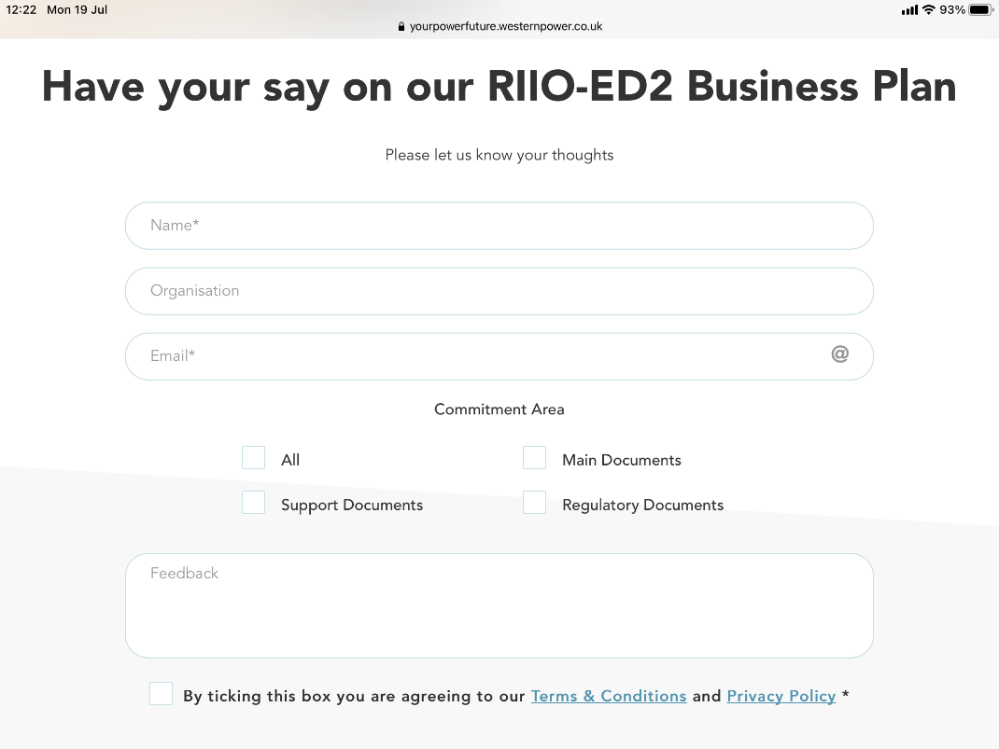
Seeking your feedback
We continue to consult on our proposals and would love to hear your views
You can comment on:
  The Business Plan as a whole
  Specific chapters
  Specific annexes
  Specific strategies
  We will continue to consult and conduct further research through to December, including:
  Stakeholder workshops: 14th-16th September
  *dates for your diary.* Likely to over:
    WPD’s Customer Value Propositions
    Acceptability of key commitments and strategy delivery areas
    Areas for potential greater ambition or alternatives
www.westernpower.co.uk/RIIO-ED2BusinessPlan
westernpower.co.uk

Slide 15
Next steps
ANY QUESTIONS?
Thank you very much for time and input into our process
westernpower.co.uk

Slide 16

www.westernpower.co.uk/
RIIO-ED2BusinessPlan

